Slide 1
Land Type Classification
Using Sentinel-2 Satellite Images & Deep Learning
EuroSAT Dataset
CNN / Transfer Learning
10 Land Classes
PyTorch
DEPI — AI & Data Science Track

Slide 2
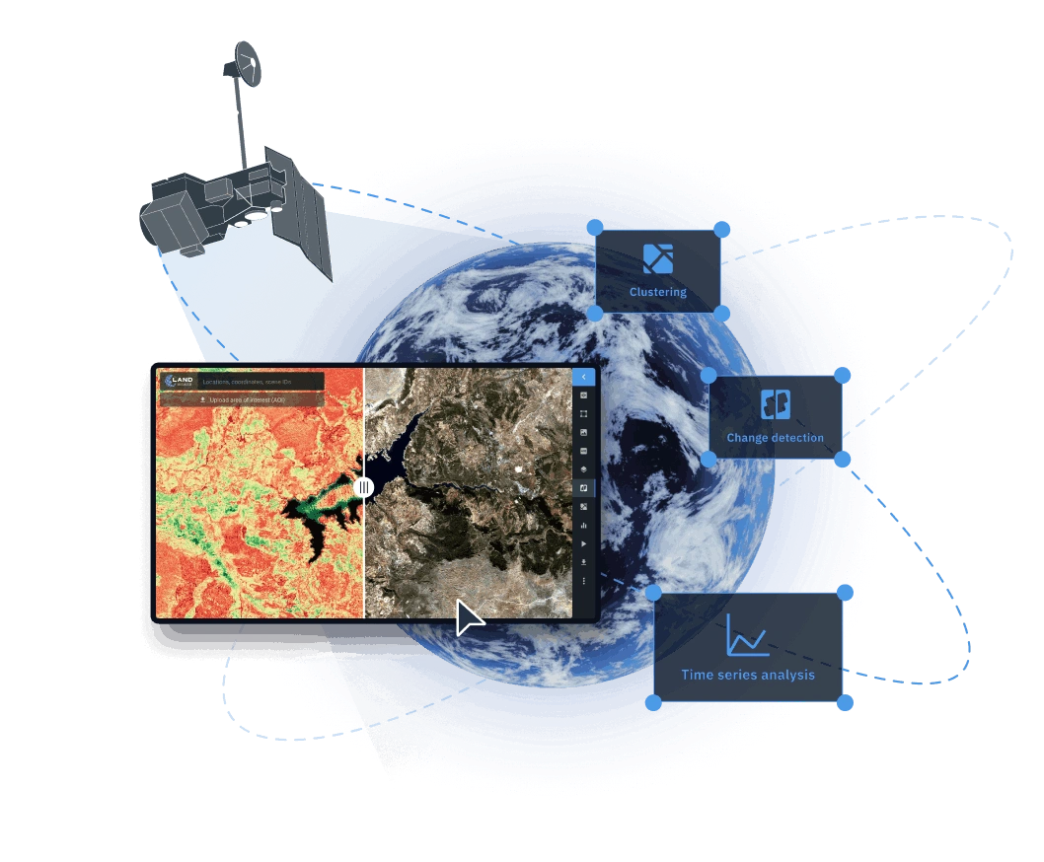
Project Overview
Our project involves classifying Land use land cover (LULC) using satellite imagery captured by the Sentinel-2 optical sensor.
Sentinel-2 is a European satellite that images the Earth every five days with a spatial resolution of up to 10 meters.
The project focuses on classifying land cover into types or categories using deep learning algorithms

Slide 3
The Problem
Challenge
Our Objective
Satellite data is massive and complex, manually labeling land use is slow, expensive, and unscalable. Accurate land classification is critical for:
Urban & infrastructure planning
Agriculture & crop monitoring
Environmental conservation
Resource management
Build a Deep Neural Network that automatically classifies land types from Sentinel-2 multispectral satellite images, across 10 categories, with high accuracy.

Slide 4

Dataset: EuroSAT (Sentinel-2)
27,000
10 Meters
64×64
13 Bands
Labeled Images
Spatial Resolution
Pixels / Image
Multi-Spectral Data
10 Land Classes:
→ Used RGB bands (2,3,4) for generalizability
1. Annual Crop
2. Forest
3. Herbaceous Veg.
4. Highway
5. Industrial
6. Pasture
7. Permanent Crop
8. Residential
9. River
10. Sea / Lake

Slide 5
Project Pipeline
1
2
3
4
5
Data Collection & Processing
EDA & Preprocessing
Model Development
Evaluation & Tuning
Deployment
Download EuroSAT 27K images
Convert .tif to JPEG RGB bands
80/10/10 train/val/test split
Class distribution analysis
Spectral band visualization
Augmentation: flip, rotate, crop
ResNet50 Transfer Learning
RGB model + MS model
Custom FC head + Dropout
Accuracy, F1-score
Confusion matrix
Train/val loss curves
Streamlit Cloud deployment
Satellite image upload & classify
Sliding-window segmentation map

Slide 6





Data Processing
NORMALIZATION
AUGMENTATION
DATA SPLIT
OPTIMIZATION
Scaling pixel values to [0, 1] for RGB and Sentinel-standard for TIF.
Random flips, rotations, and brightness shifts to boost robustness.
70% Train, 20% Val, 10% Test using stratified sampling.
PyTorch pipelines with caching and prefetching.
RGB — Confusion Matrix
Multispectral — Confusion Matrix
Reproducibility: Fixed random seeds used for consistent dataset shuffling and splitting.
Efficiency: Parallelized loading and RAM caching to minimize training bottlenecks.

Slide 7
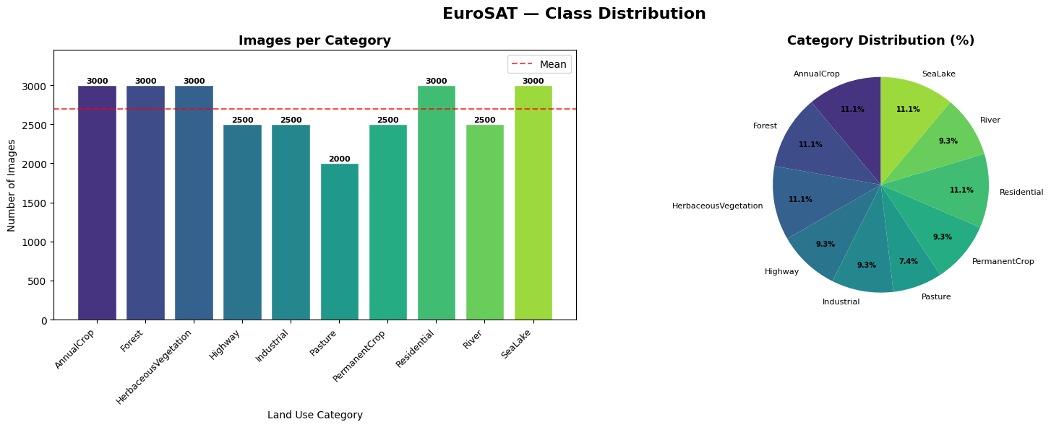
Exploratory Data Analysis Results
Class Distribution Charts
RGB — Confusion Matrix
Multispectral — Confusion Matrix

Slide 8
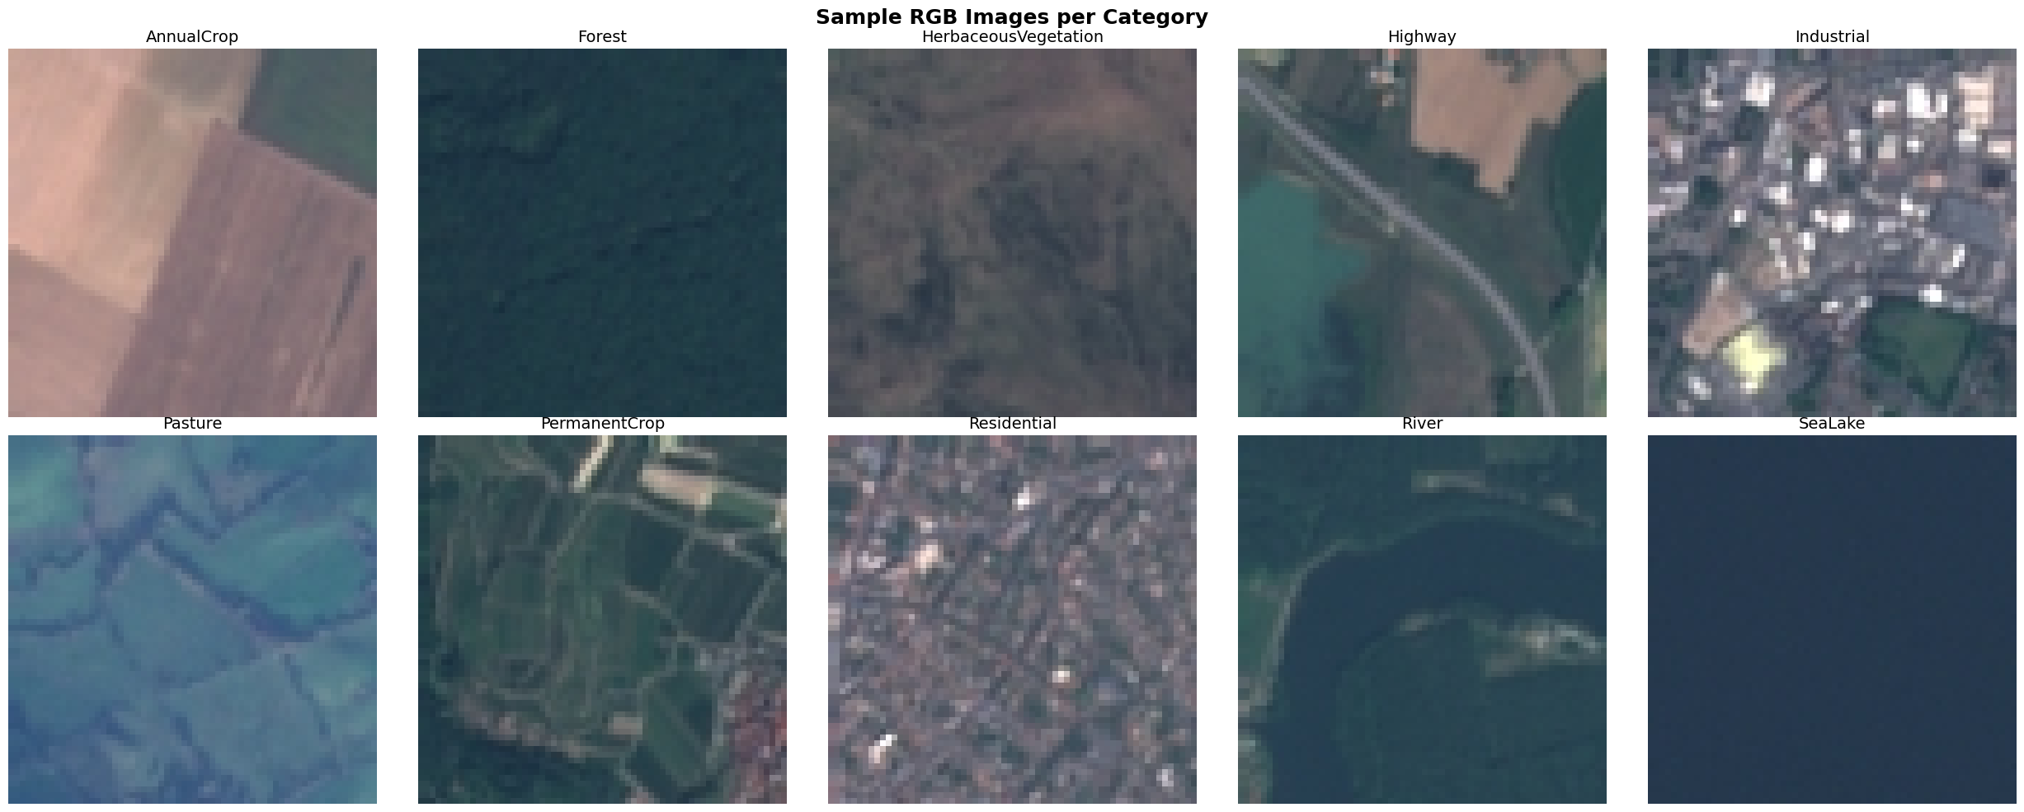
Exploratory Data Analysis Results
Sample Images From Each Category
RGB — Confusion Matrix
Multispectral — Confusion Matrix

Slide 9
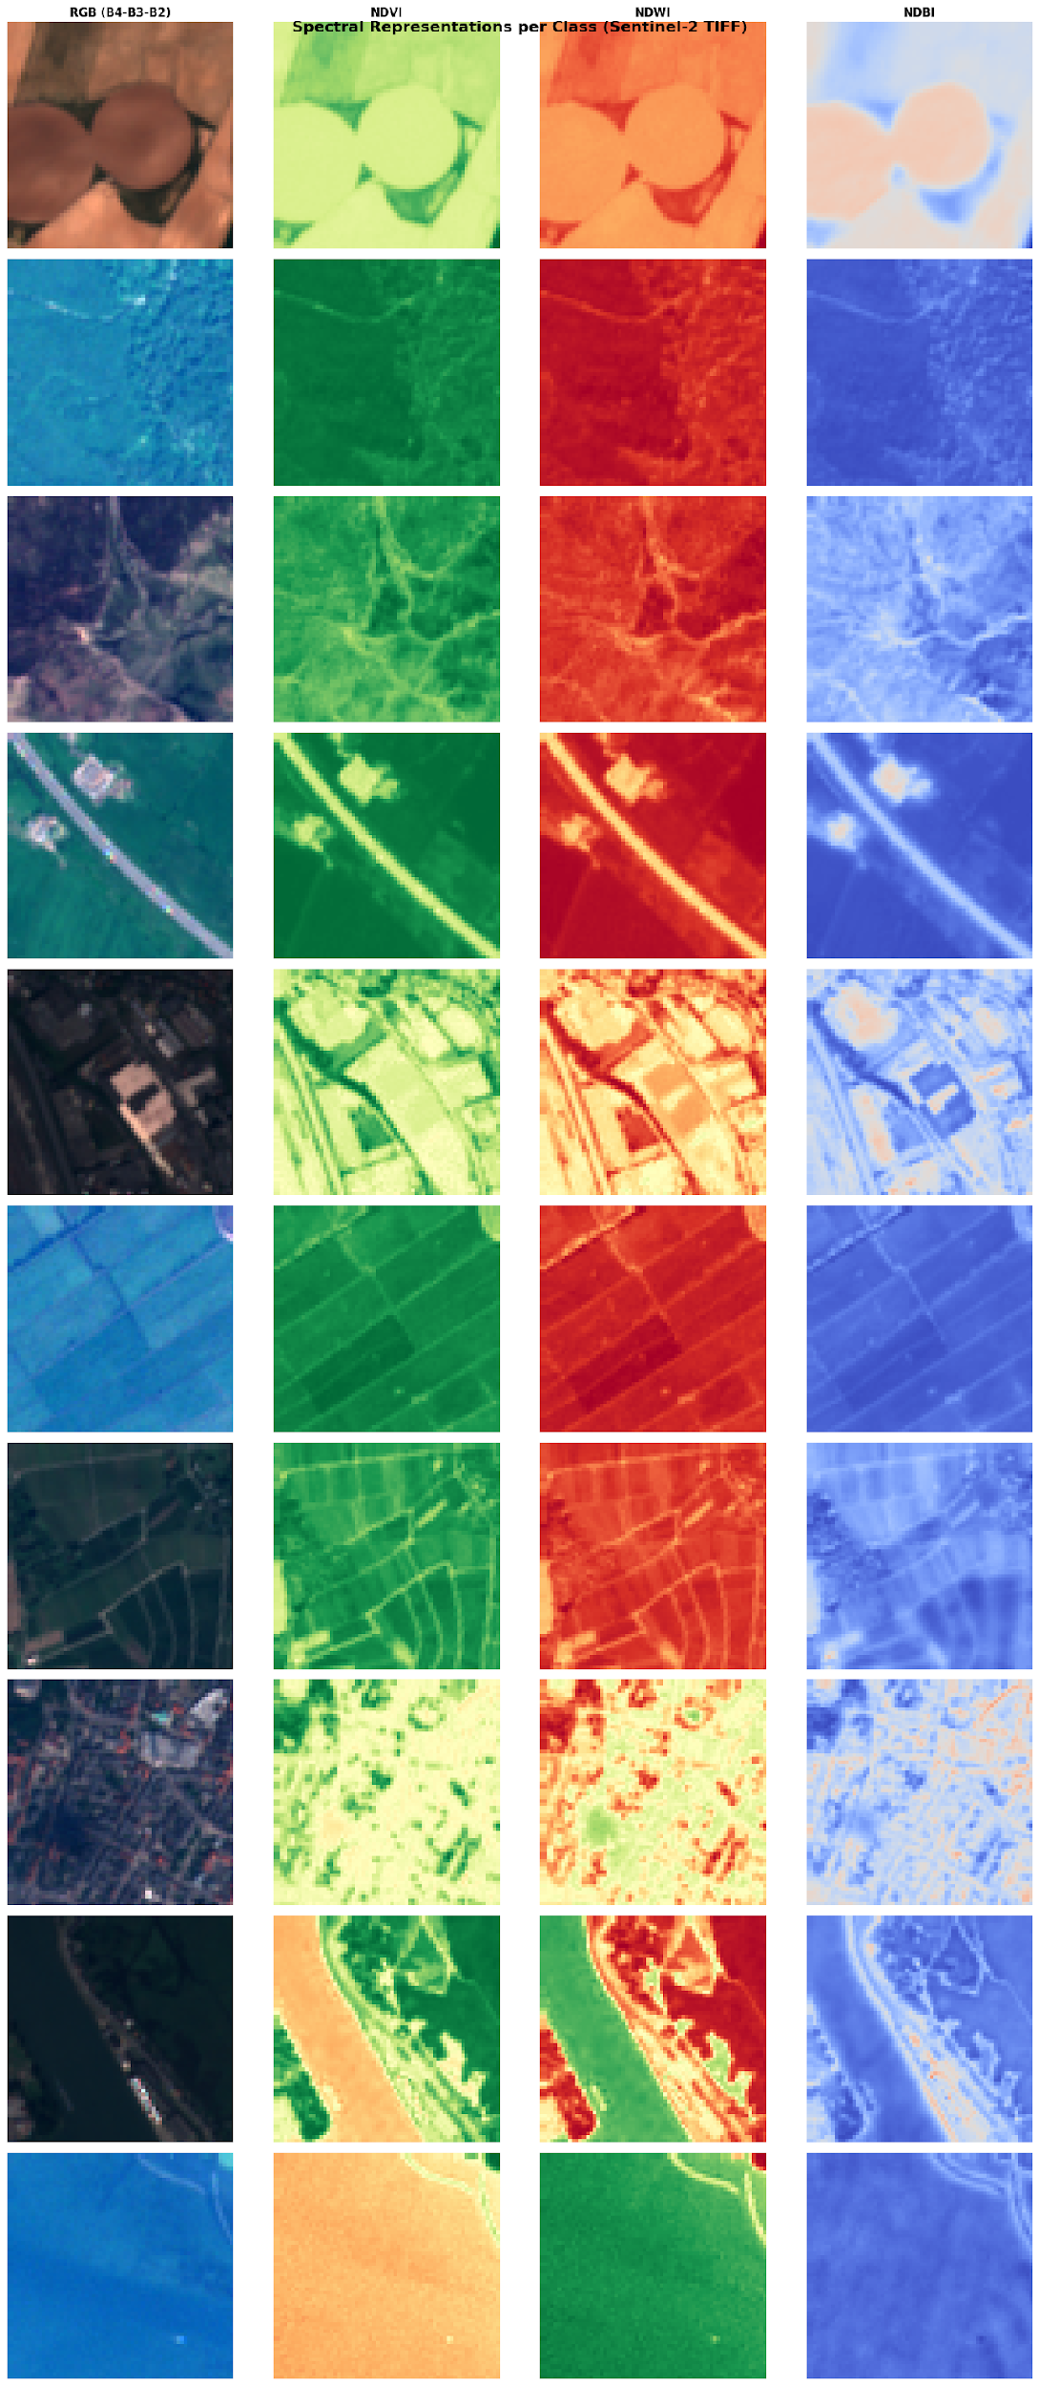
Exploratory Data Analysis Results
Displays RGB composite, NDVI, NDWI, and NDBI for one sample per class
RGB — Confusion Matrix
Multispectral — Confusion Matrix

Slide 10
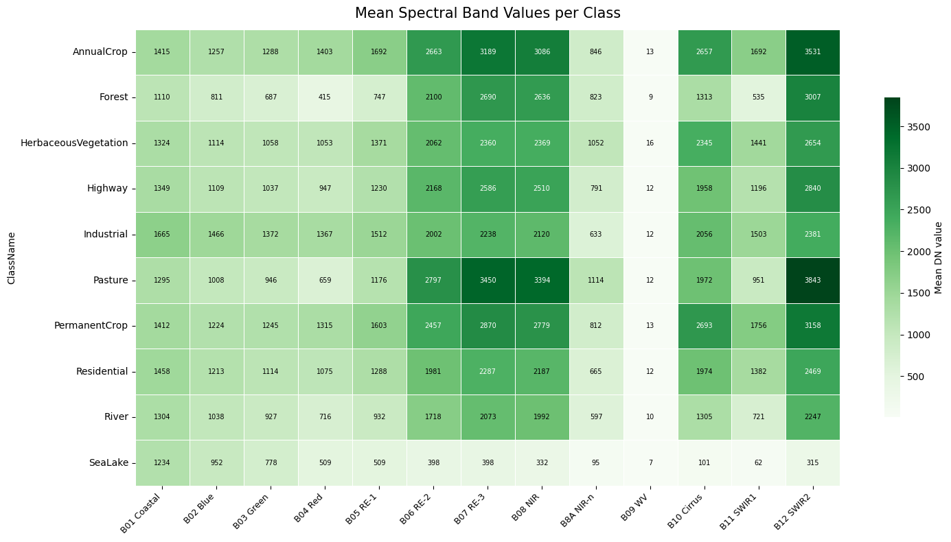
Exploratory Data Analysis Results
Mean Spectral Band Values per Class
RGB — Confusion Matrix
Multispectral — Confusion Matrix

Slide 11
Exploratory Data Analysis Results
Top 5 Bands Per Class
Class Name | Rank 1 | Rank 2 | Rank 3 | Rank 4 | Rank 5
Annual Crop | B12 SWIR2 | B07 RE-3 | B08 NIR | B06 RE-2 | B10 Cirrus
Forest | B12 SWIR2 | B07 RE-3 | B08 NIR | B06 RE-2 | B10 Cirrus
HerbaceousVegetation | B12 SWIR2 | B08 NIR | B07 RE-3 | B10 Cirrus | B06 RE-2
Highway | B12 SWIR2 | B07 RE-3 | B08 NIR | B06 RE-2 | B10 Cirrus
Industrial | B12 SWIR2 | B07 RE-3 | B08 NIR | B10 Cirrus | B06 RE-2
Pasture | B12 SWIR2 | B07 RE-3 | B08 NIR | B06 RE-2 | B10 Cirrus
PermanentCrop | B12 SWIR2 | B07 RE-3 | B08 NIR | B10 Cirrus | B06 RE-2
Residential | B12 SWIR2 | B07 RE-3 | B08 NIR | B06 RE-2 | B10 Cirrus
River | B12 SWIR2 | B07 RE-3 | B08 NIR | B06 RE-2 | B10 Cirrus
Sea/Lake | B01 Coastal | B02 Blue | B03 Green | B04 Red | B05 RE-1
RGB — Confusion Matrix
Multispectral — Confusion Matrix

Slide 12
Model Development
Architecture: ResNet50 • Framework: PyTorch • Optimizer: Adam (lr=0.001) • Loss: CrossEntropyLoss • Epochs: 10
RGB Model
3-channel input
Multispectral Model
13-channel input
Base Model
ResNet50 (pretrained — ImageNet)
Base Model
ResNet50 (random weights — no pretrain)
Frozen Layers
All except FC head
Modified Conv1
Conv2d(13→64, k=7, stride=2) — custom input
Custom Head
Linear(2048→512) → ReLU → Dropout(0.5) → Linear(512→N)
Frozen Layers
All except conv1 + FC head
Input
3-channel RGB images
Custom Head
Linear(2048→512) → ReLU → Dropout(0.5) → Linear(512→N)
Trained Params
FC head only (fast fine-tuning)
Trained Params
conv1 + FC head (13-band specialization)
Training loop: forward pass → CrossEntropyLoss → backprop → Adam step | Tracked per epoch: train/val loss & accuracy | Saved to Google Drive (.pth)

Slide 13
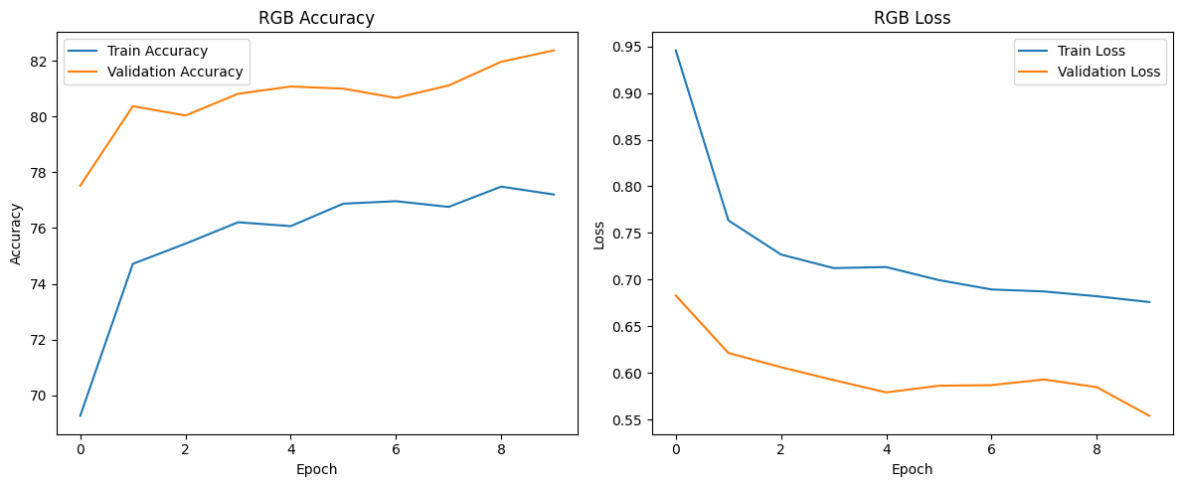
Training Results
RGB Model — Accuracy & Loss Curves
RGB — Confusion Matrix
Multispectral — Confusion Matrix

Slide 14
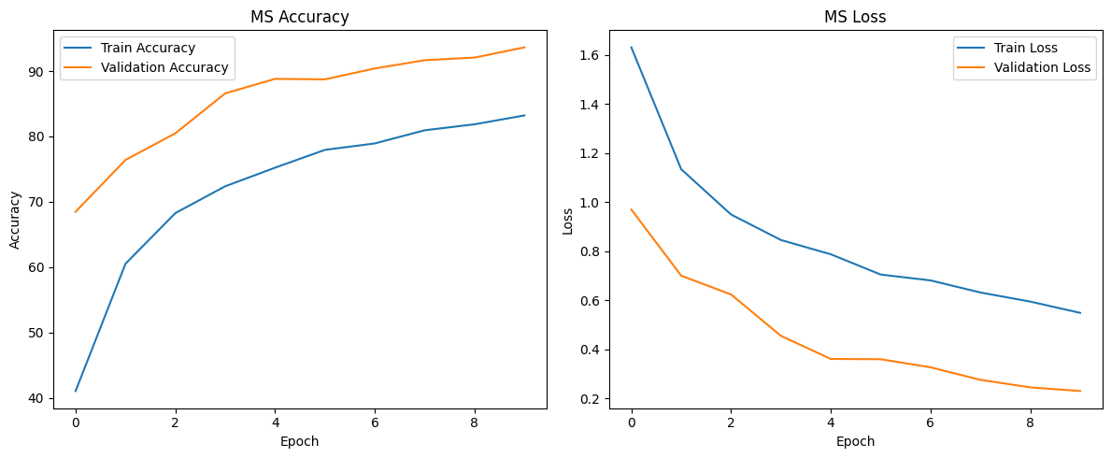
Training Results
MS Model — Accuracy & Loss Curves
RGB — Confusion Matrix
Multispectral — Confusion Matrix

Slide 15
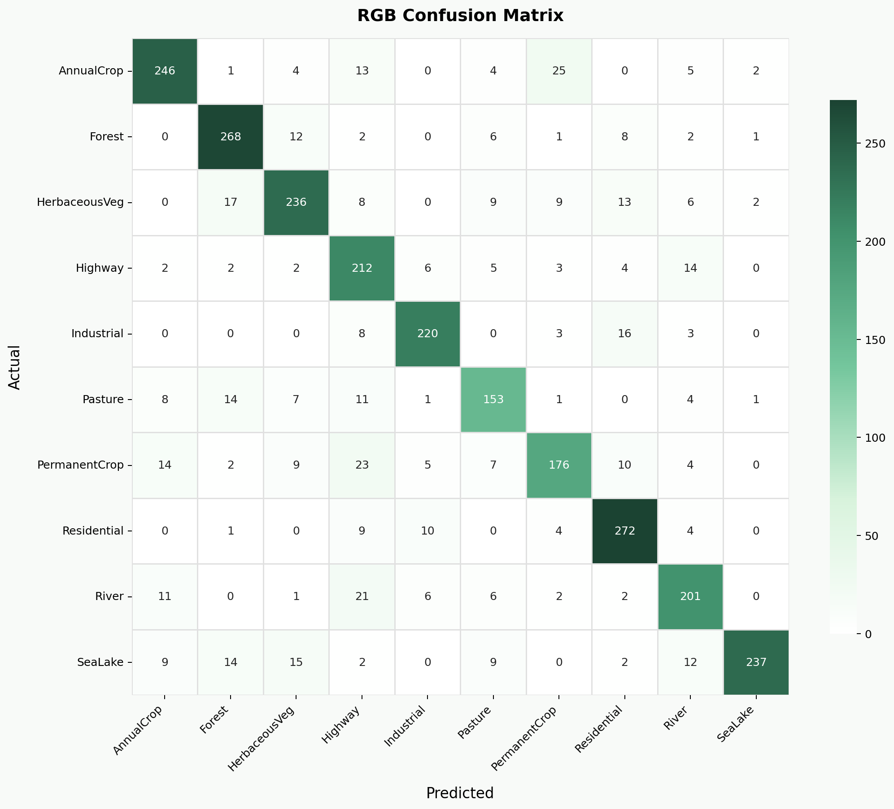

Training Results
RGB & MS — Confusion Matrix
RGB — Confusion Matrix
Multispectral — Confusion Matrix

Slide 16
Model Results
Simple CNN
CNN + Batch Norm
★ BEST MODEL
Transfer Learning
(ResNet-50)
~84%
~56%*
~95%
Accuracy
Accuracy
Accuracy
Baseline architecture
3 conv blocks
Overfit after ~10 epochs
Faster convergence
Still improving at 10 epochs
13h vs 34h training
Pre-trained on ImageNet
Fine-tuned on EuroSAT
Best generalization
* Batch Norm model still improving at epoch 10 — expected to exceed with more training

Slide 17


Engineering the Pipeline
Development Environment & Project Structure
Google Colab
DEPI_DataScience_Project/
├── config.py # Hyperparameters & paths
├── data_loader.py # RGB & MS handling
├── model.py # ResNet50 architecture
├── engine.py # Training logic & AMP
├── train.py # Command Line execution
├── app.py # Streamlit Dashboard — classification & segmentation
├── requirements.txt # Dependencies
└── README.md # Project Documentation
GitHub

Slide 18
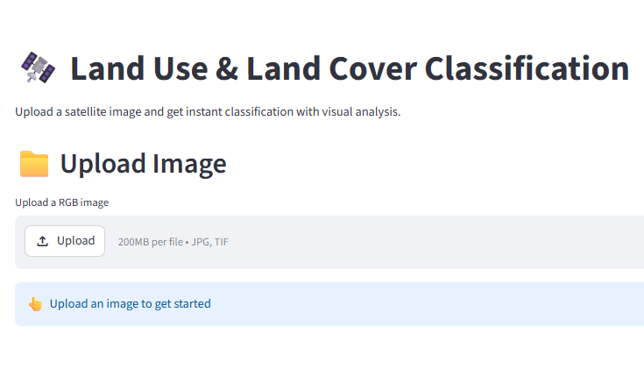
Interactive Deployment: Streamlit Engine
Deployment & Interactive Dashboard
Streamlit Web Application
Dashboard Deployment: Deployed on Streamlit Cloud with a clean two-tab interface for instant access from any browser.
Real-Time Inference: Instant LULC classification across 10 land-cover categories for .jpg (RGB) or .tif (13-band MS) Sentinel-2 patches, with Top-3 probability scores.
Segmentation Map: Sliding-window analysis divides large images into 64x64 patches, classifies each independently, and renders a colour-coded land-cover map with area statistics.
Geospatial Insights: Toggle between RGB Natural Color and False Color Composite (NIR-Red-Green) views to highlight vegetation health across the uploaded scene.

Slide 19
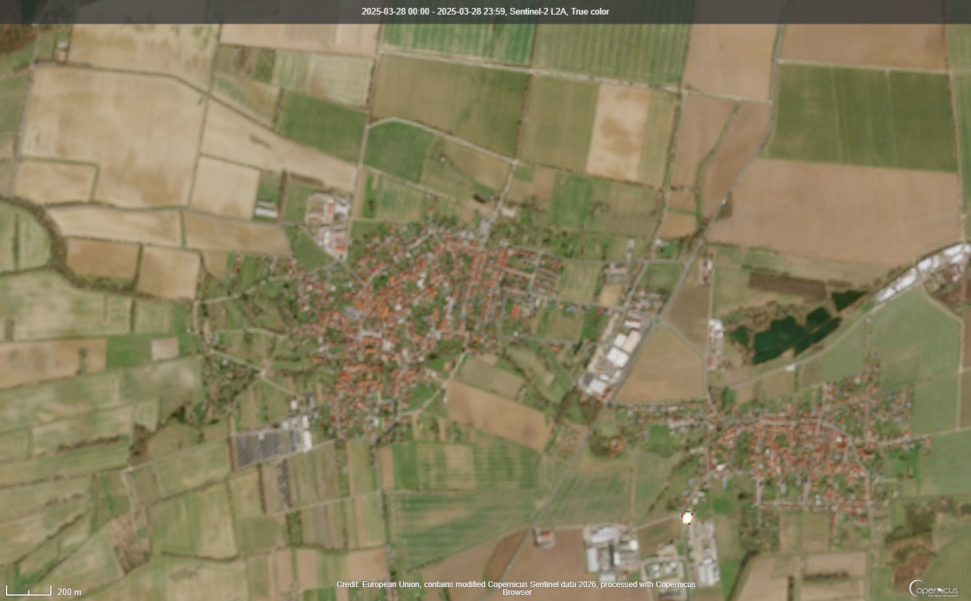


Interactive Deployment: Streamlit Engine
Deployment & Interactive Dashboard
Oberdorla, Germany
https://browser.dataspace.copernicus.eu/

Slide 20
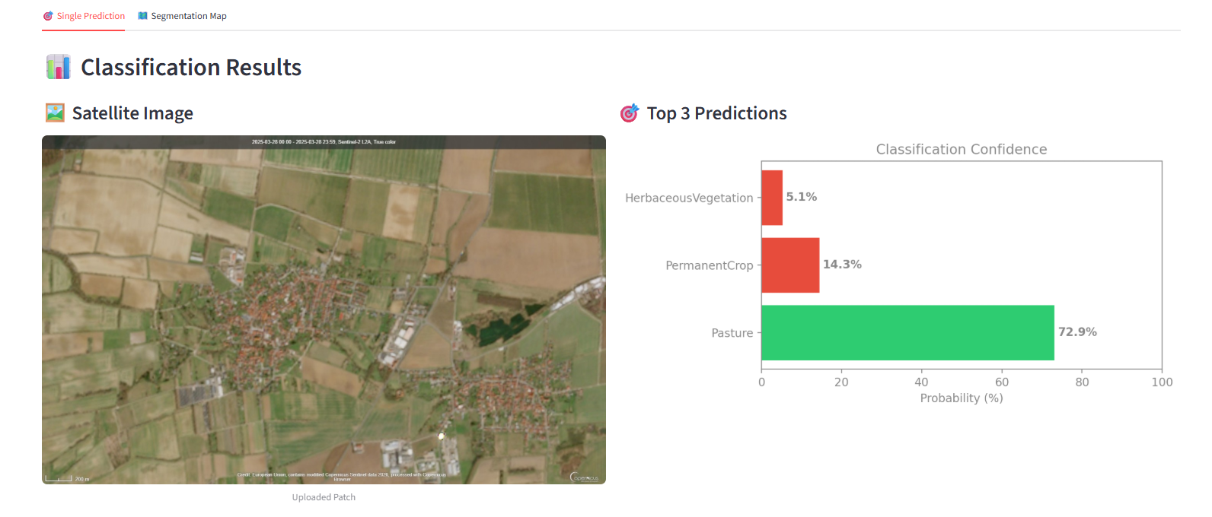
Interactive Deployment: Streamlit Engine
Deployment & Interactive Dashboard
Interactive Dashboard UI Preview

Slide 21
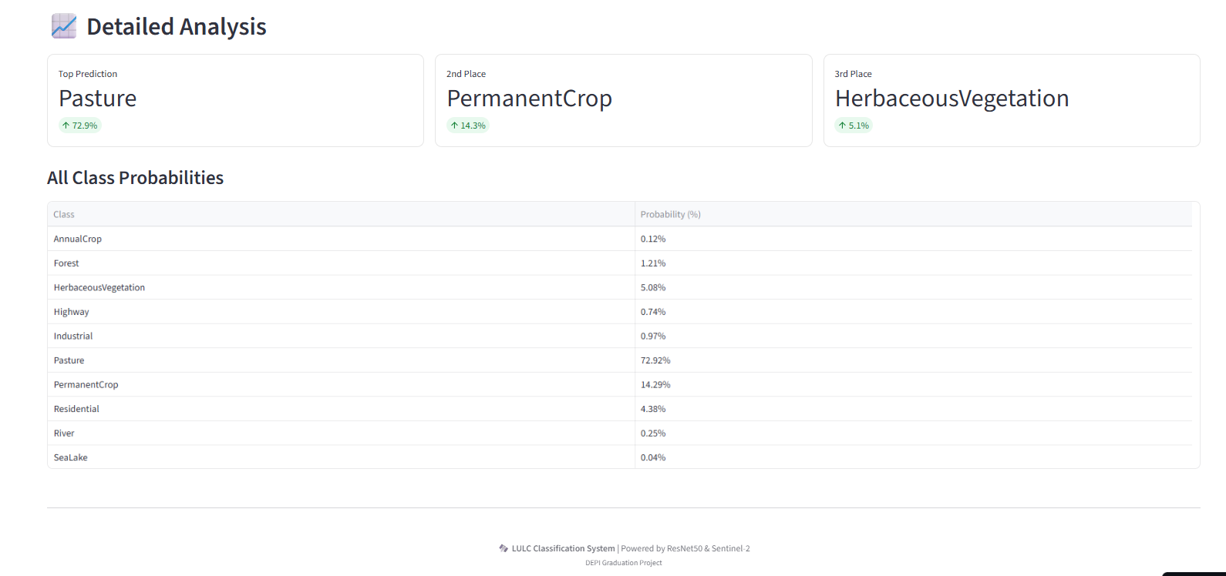
Interactive Deployment: Streamlit Engine
Deployment & Interactive Dashboard
Interactive Dashboard UI Preview

Slide 22
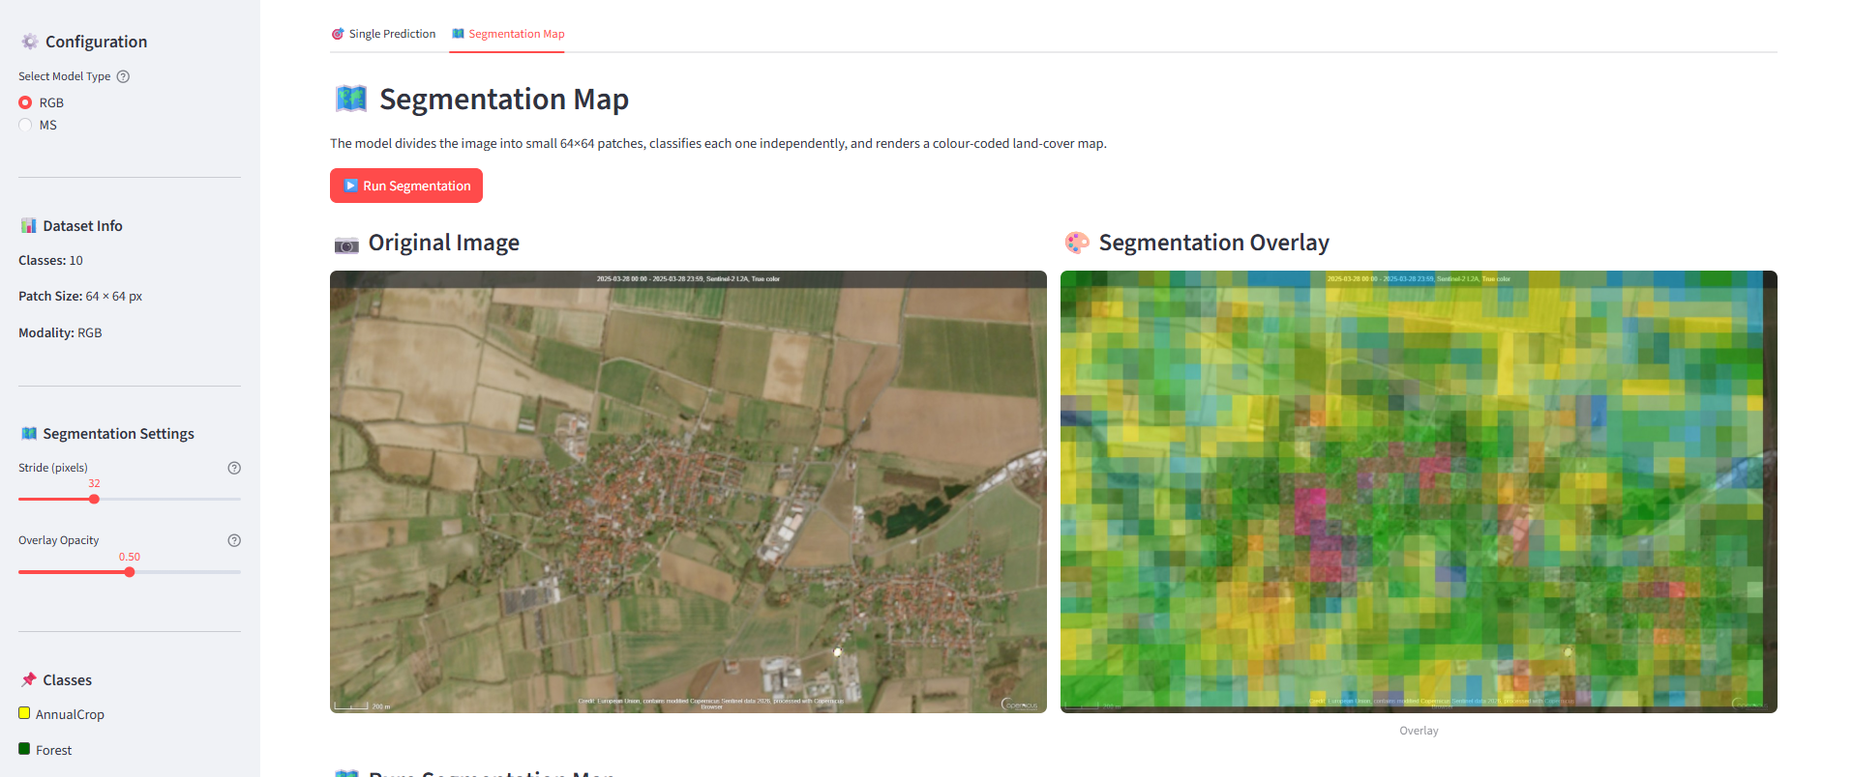
Interactive Deployment: Streamlit Engine
Deployment & Interactive Dashboard
Interactive Dashboard UI Preview

Slide 23
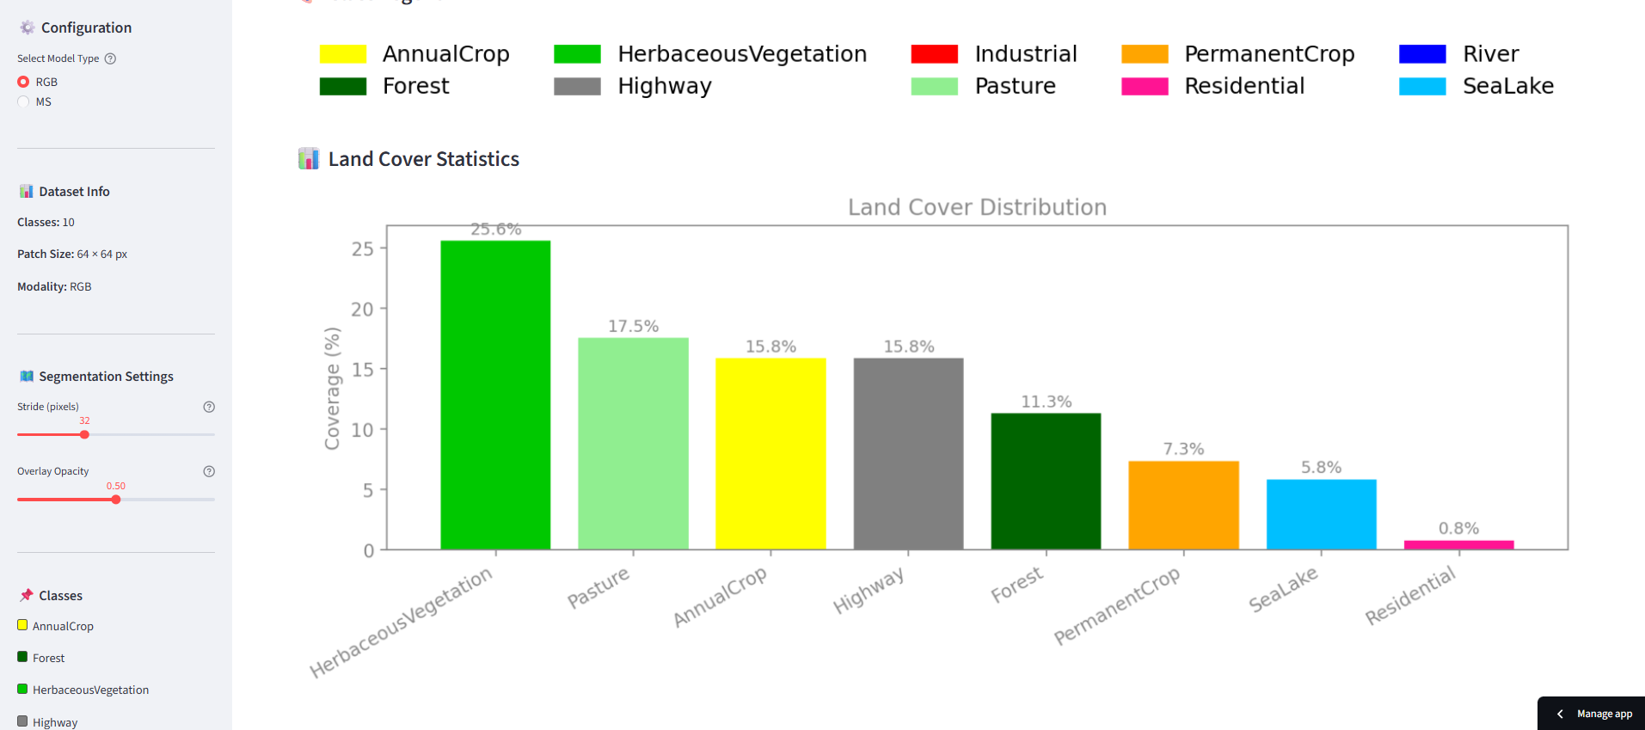
Interactive Deployment: Streamlit Engine
Deployment & Interactive Dashboard
Interactive Dashboard UI Preview

Slide 24
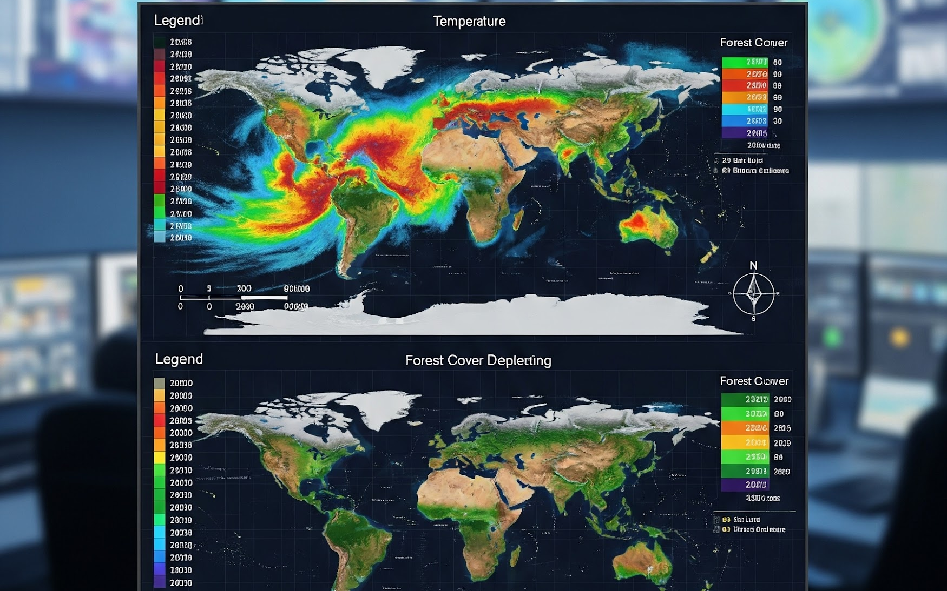
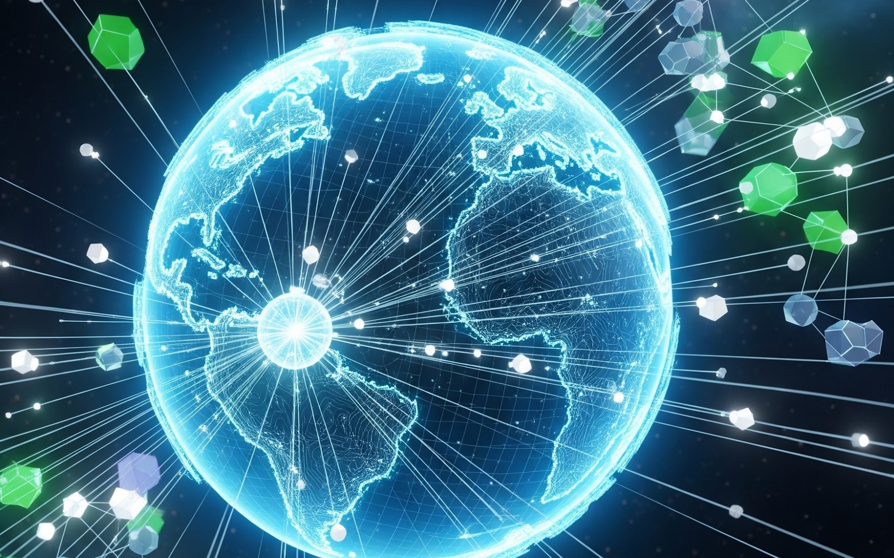
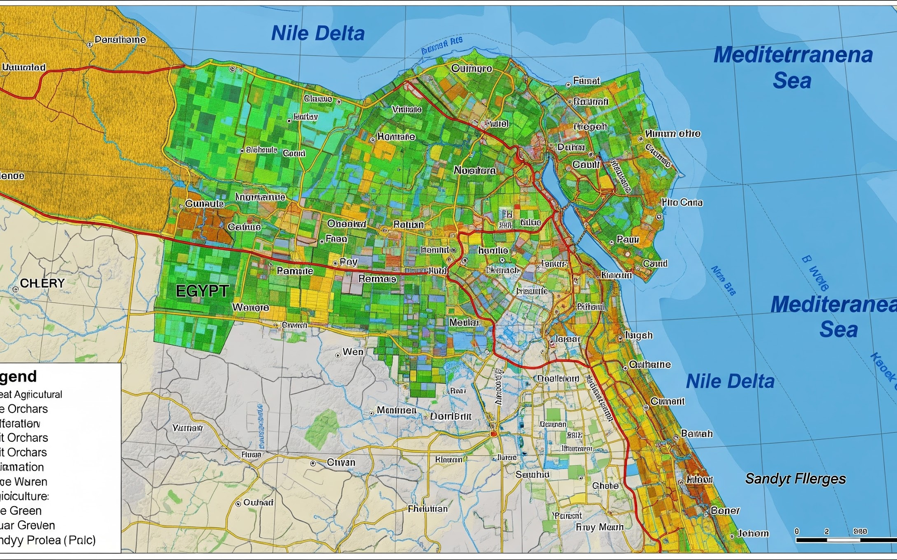
Future Scope: Scaling the Geospatial Impact
Long-term Evolution & Regional Integration
Climate & Change
Correlate LULC shifts with environmental variables for long-term predictive models and automated deforestation tracking.
Live Integration
Direct live connections with Sentinel-2 API and Google Earth Engine for on-demand regional analysis and cloud processing.
Regional Fine-Tuning
Adapting the ResNet50 backbone to Egyptian landscapes and Nile Delta topographies for agricultural monitoring and urban planning.

Slide 25



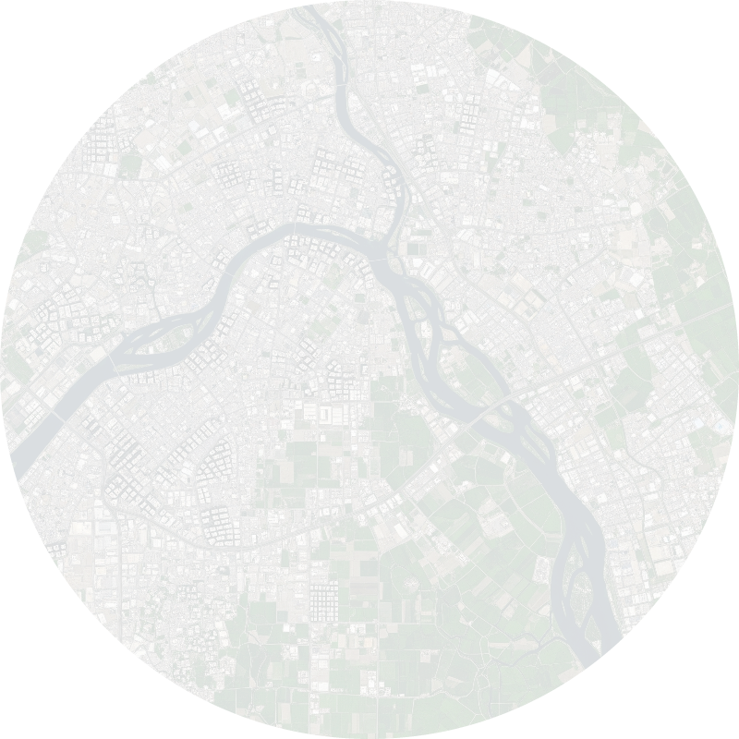

Real-World Impact: Transforming Geospatial Data into Action
Deploying Advanced ML for National Development & Sustainability
Combating Urban Sprawl
Automatically detecting illegal construction and urban encroachment on valuable agricultural land in the Nile Delta.
Precision Agriculture
Utilizing 13-band Multispectral and False Color Composites to monitor crop health and predict harvest yields.
Water Resource Management
Continuously tracking water levels and pollution in the Nile River and northern coastal lakes.
Smart City Planning
Assisting government entities in mapping terrain for new urban developments and optimizing highway routing.

Slide 26


THANK YOU!
For your time and attention
PROJECT TEAM
Nourhan Magdy
Abdelrahman Ashraf
Eslam Abdin
Heba Adel
Ahmed Abdelkhalek
Neamat Gamal
https://depidatascienceproject-zfm6ugw4g6h74ak3svcwfc.streamlit.app/
https://github.com/nhahub/NHA-4-047

